Slide 1
HAMITONIAN CIRCUITS
(using backtracking method)

Slide 2
Definition
A hamiltonian circuit in a connected graph defined as a closed walk that traverse every vertex of G exactly once except the starting vertex at which the walk also terminate.
A graph possessing a hamiltonian circuit is said to be a hamiltonian graph. The hamiltonian circuit is names after sir William Rowan Hamilton

Slide 3


Slide 4
Definition
Backtracking constructs its state-space tree in the depth–first search fashion in the majority of its applications
If the sequence of choices represented by a current node of the state-space tree can be developed further without violating the problems constraints
It is done by considering the first remaining legitimate option for the next component of the partially built solution and replace it by the next alternative

Slide 5
Backtracking algorithm
Algorithm backtracking(X[1…..i])
i=0; X[1…0] \ it reprints the empty tuple
//Given a template of a generic backtracking algorithm
//Input : X[1…i] specifies first I promising components of a solution
//Output: All the tuples representing the problems solutions

Slide 6
Continue…
If X[1…i] is a solution write X[1…..i]
Else
For each element x € S i+1 consistent with X[1…..i] and the constraints
Do
X[i…..1] x
Backtrack (X[1…i + 1] )

Slide 7
EXAMPLE FOR HAMILTON CIRCUIT (USING BACKTRACKING METHOD)
a
b
c
f
d
e

Slide 8
CONTINUE…
a
b
f
c
e
d
e
c
e
d
f
Dead end
d
Dead end
f
a
Dead end
Found

Slide 9
RELATION BETWEEN HAMILTON AND TSP
An optimal Hamilton circuit of a graph is one with the smallest possible weight. There can be more than one.
The problem of finding an optimal Hamilton circuit in a complete weighted graph is often called TSP(Traveling salesman problem).
Commonly referred to as a TSP it simulates a salesman who must visit each node preferably once go home at the end of the day and have traveled the least distance needed. Any path the salesman takes is a Hamiltonian circuit.

Slide 10
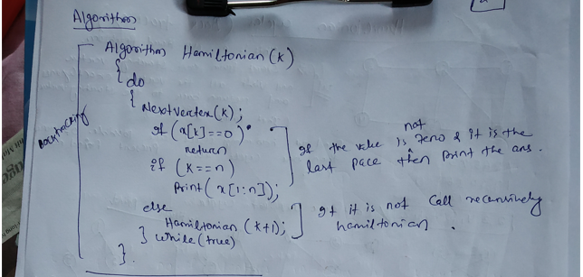

Slide 11
